Slide 1
Grading Criterion (use pts instead of points for short):
25 pts for each question.
Q1:
-25 pts: The program cannot run. Or, no ideas how to run it.
-20 pts: The program can run and get the same results without looping programming
-5 ~ -20 pts: Some outputs are not matched with the requests.
Q2~Q4:
-25 pts: The program cannot run. Or, no ideas how to run it.
-20 pts: The programs cannot fulfill the main purpose of this question.
-5 ~ 20 pts: Some outputs are not matched with the requests.

Slide 2
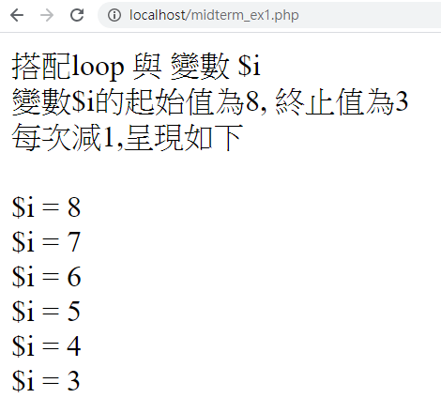
Q1)搭配loop與變數$i;變數$i的起始值為8,終止值為3,每次減1,呈現在Browser如下.
midterm_ex1.php

Slide 3
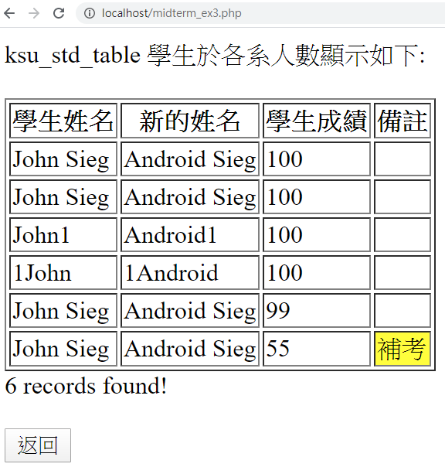
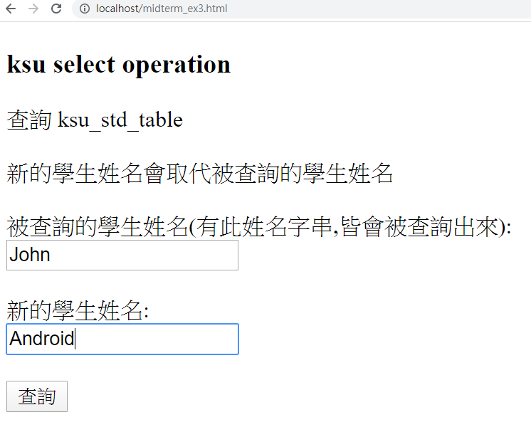
Q2) Please show the results as follows. The student name being searched and new one will be passed to the backend program. Additionally, the new one is used and showed on the output instead of the searched name.
midterm_ex3.html
Midterm_ex3.php

Slide 4
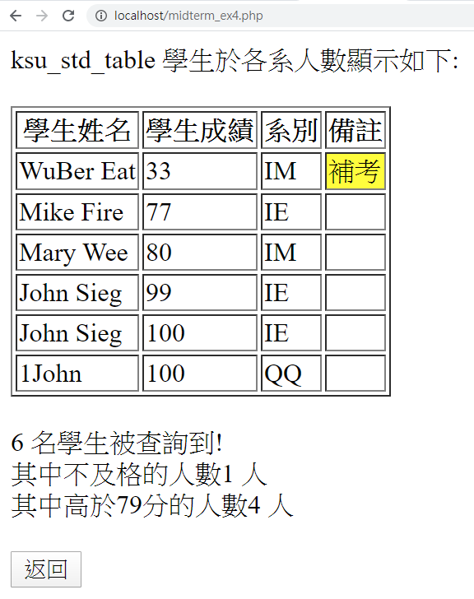
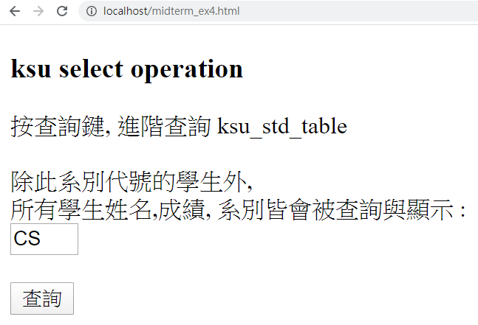
Q3) Please show the results as follows. The backend program just search the students that department is not the same as the one passed by the frontend interface. Your results need to demonstrate the total number of students found, the number of students failed, and the number of students’ grades than 79.
midterm_ex4.html
Midterm_ex4.php

Slide 5
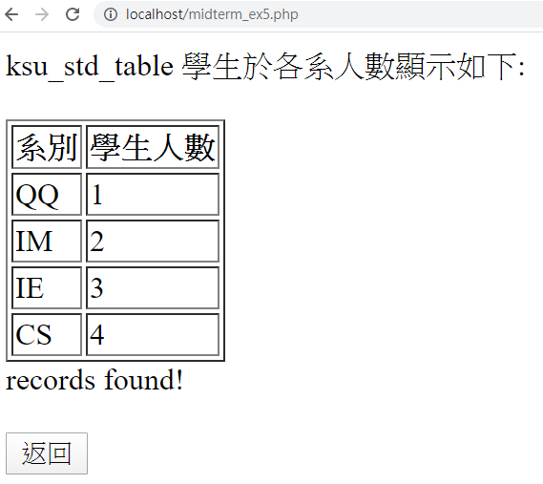

Q4) Please show the results as follows. Your backend program has to process the assigned table, and classify the department number and calculate the its corresponding student numbers.
midterm_ex5.html
Midterm_ex5.php

